Slide 1

STUDENT PLACEMENT MANAGEMENT SYSTEM
Theme - SDG 4 – Quality Education
Category - Software
Group No - 11
Group Members - Sanwar Mukkirwar
Waqqas Mulla
Pragati Nayak
Riya Patil
Guide - Prof. Rashmi Dhake

Slide 2
OUTLINE
Introduction
Literature Survey
Limitations of existing systems
Problem statement and Objectives
Proposed Methodology
Experimental Setup
Implementation
Results & Analysis
Conclusion and Future work
References

Slide 3
INTRODUCTION
BACKGROUND:
In our college, the placement process was traditionally managed using Google Forms for collecting student data.
After students filled the form, their responses were manually transferred and maintained in Excel sheets.
Whenever a new company visited the campus, the placement officer shared the company details in WhatsApp groups.
As the number of students increased, managing records manually became difficult. Filtering eligible students based on CGPA, branch, or other criteria required manual checking in Excel sheets.
This process was time-consuming and prone to human errors. To overcome these issues, we developed a *Digital Student Placement Management System* using HTML, CSS, JavaScript, and MYSQL.

Slide 4
IMPORTANCE OF THE PROBLEM:
Placement management is a critical process in educational institutions. An inefficient system can lead to:
Delayed communication
Incorrect eligibility selection
Data inconsistency
Lack of transparency
A structured digital system ensures better organization, faster processing, and improved reliability. CURRENT CHALLENGES:
Repeated creation of Google Forms for every company.
Manual updating and maintenance of Excel sheets.
Manual checking of eligibility criteria.
Scattered communication via WhatsApp groups.
Difficulty in managing large volumes of student data.
No centralized tracking of applications.
Time-consuming and error-prone process

Slide 5
MOTIVATION (Mapped with SDG 4 – Quality Education)
The motivation behind this project was the need to improve the efficiency of placement management and contribute towards
*SDG 4 (Quality Education)* by implementing digital transformation in academic administration. Observing delays, manual workload, and lack of automation strongly motivated us to develop a centralized web-based system.
OBJECTIVES
To create a centralized placement portal.
To replace Google Forms and Excel sheets.
To implement secure login for students, department admin,TPO.
To allow real-time company updates.
To enable structured storage of student and company data.
To automate the application tracking process.

Slide 6
LITERATURE SURVEY
SURVEY OF EXISTING SOLUTIONS IN THE REAL WORLD
Manual Systems
Excel sheets for student & company data
Manual eligibility checking
2. Google Forms
Collects student data
Requires repeated form creation
3. ERP Modules
Centralized database
High cost & maintenance
4. Campus Portals
Web-based systems
Role-based login
Observation: Many institutions still use semi-manual methods.

Slide 7
SUMMARY OF LITERATURE REVIEW
Author & Year with Citation [ ] | Techniques / Method Used | Dataset Used | Key Results | Limitations
Sharma & Patel, 2019 [1] | Web-based placement portal using HTML, PHP, MySQL | Student academic records | Improved placement communication and centralized data | Limited automation and analytics
Kumar et al., 2020 [2] | Cloud-based placement management system | Student profiles and recruiter data | Faster data access and remote usability | Security concerns and limited customization
Singh & Kaur, 2021 [3] | Resume filtering using rule-based algorithms | Resume database | Efficient candidate shortlisting | Not adaptable to dynamic job requirements
Reddy et al., 2022 [4] | Firebase-based real-time placement portal | Student and job posting data | Real-time updates and easy access | Dependent on internet connectivity

Slide 8
LIMITATIONS OF EXISTING SYSTEMS
From the literature survey and real-world observations, the following limitations were identified:
Manual dependency on Google Forms for data collection
Data duplication and inconsistency in Excel sheets
Lack of a centralized application dashboard
High time consumption in managing placement activities
Increased chances of human errors
Lack of structured role-based access control
Limited automation; many processes still require manual effort
Absence of real-time updates and synchronization
Security and data privacy concerns in cloud-based systems
Poor adaptability to dynamic job requirements
High dependency on internet and limited scalability
These limitations are effectively addressed in the proposed system.

Slide 9
SURVEY OF METHODOLOGIES / TECHNIQUES USE
Role-Based Authentication: Used to provide different access levels for students and administrators.
Web Technologies (HTML, CSS, JavaScript): Used for developing user-friendly and interactive web interfaces.
Database Management Systems (MySQL): Used for storing and managing student, company, and application data.

Slide 10
PROBLEM STATEMENT AND OBJECTIVES
To address the inefficiencies in the existing placement process caused by the use of multiple unintegrated platforms for data collection, storage, and communication, which results in lack of centralized access, difficulty in managing large datasets, and absence of a structured mechanism for tracking student applications and placement activities.
To design and develop a centralized, web-based Student Placement Management System with multi-level role-based access for students, department coordinators, and the TPO, enabling efficient data management, real-time updates, and systematic tracking and monitoring of placement activities across all departments.

Slide 11
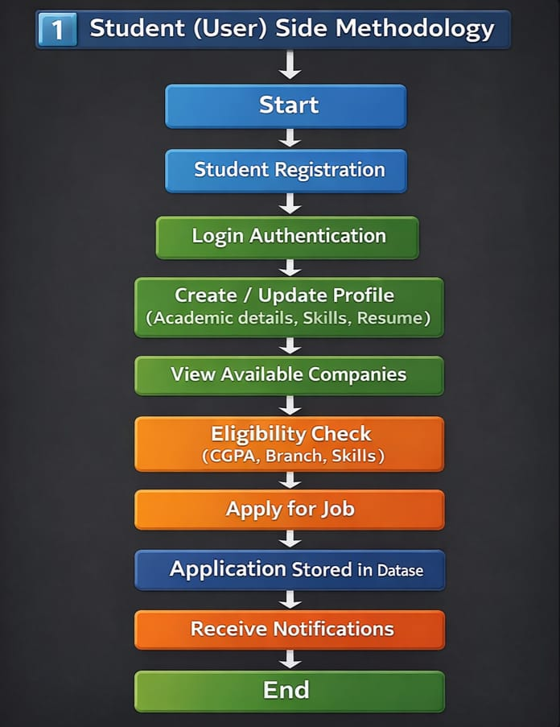
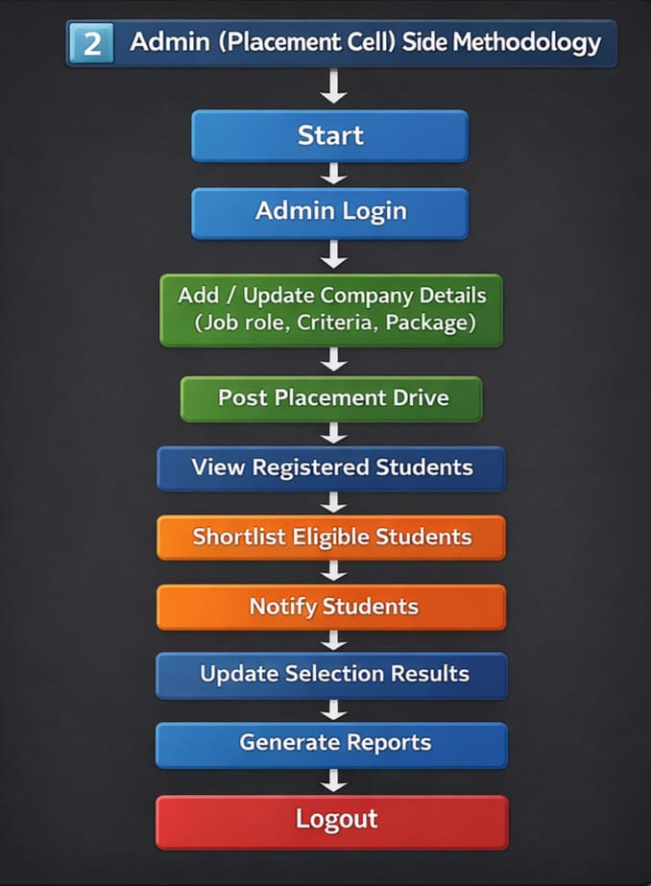
PROPOSED METHODOLOGY

Slide 12
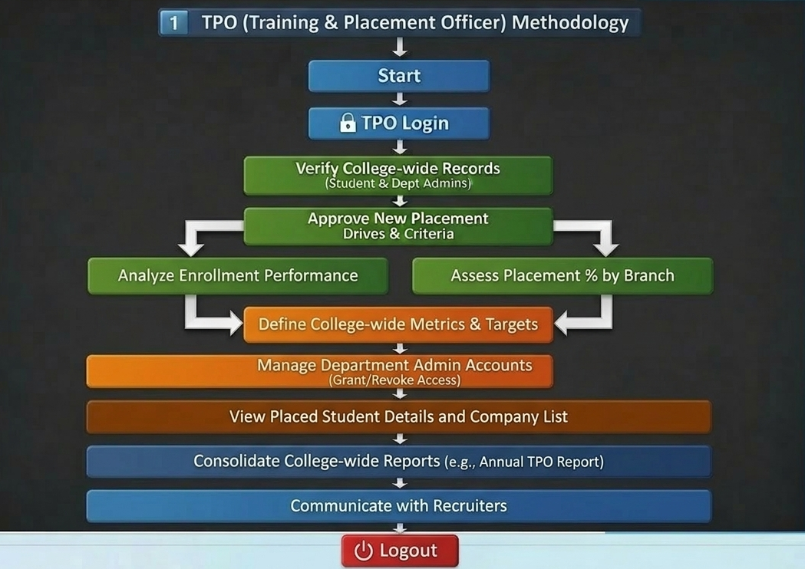

Slide 13
EXPERIMENTAL SETUP
Hardware Requirements
Laptop/Desktop
Minimum 4GB RAM
Internet connection
Software Requirements
VS Code
Google Chrome Browser
MY SQL Workbench
Dataset
Student personal and academic details
Company information (name, role, eligibility criteria)
Application records of students
Department Coordinator (Admin) details
TPO (Training and Placement Officer) details

Slide 14
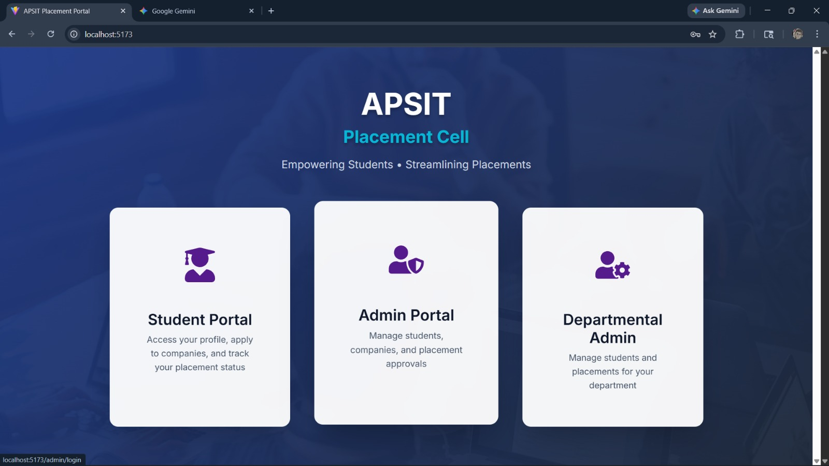
IMPLEMENTATION

Slide 15
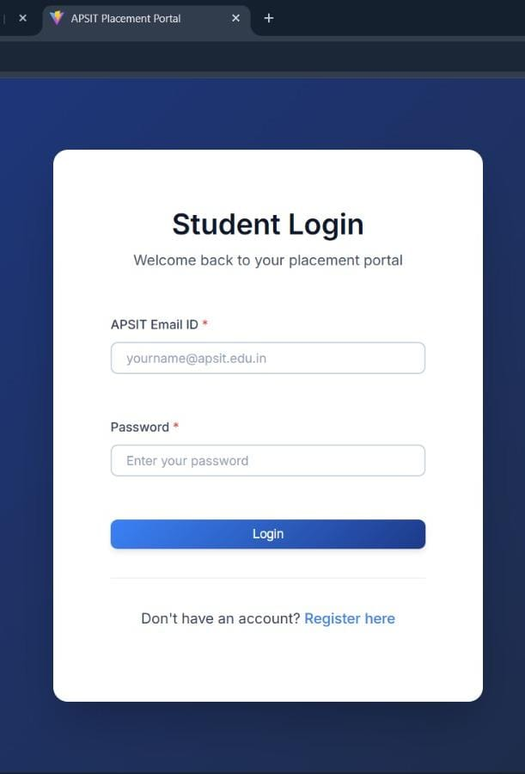
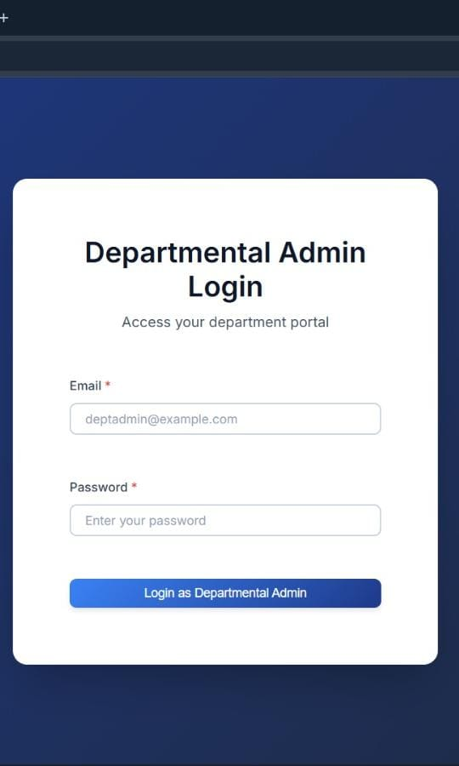
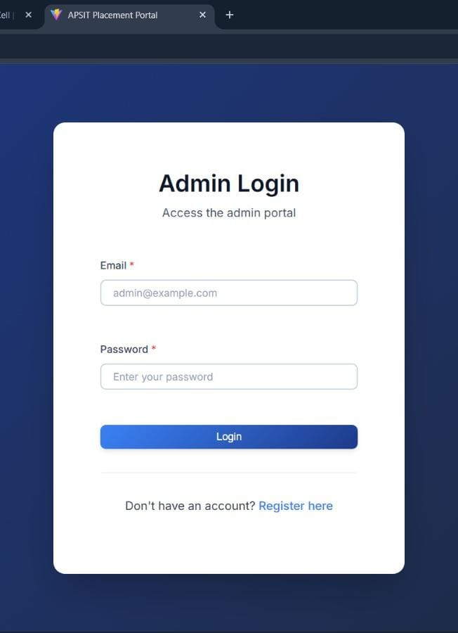

Slide 16
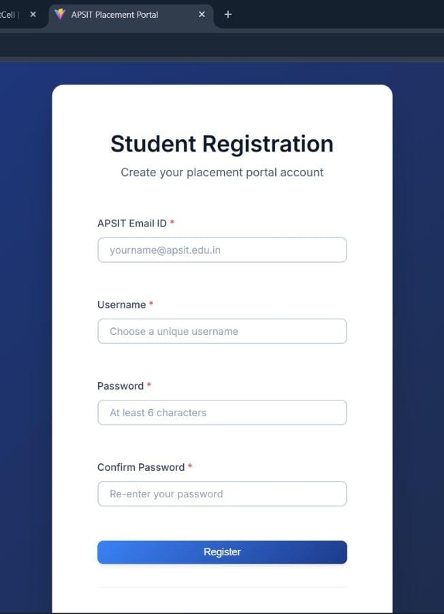
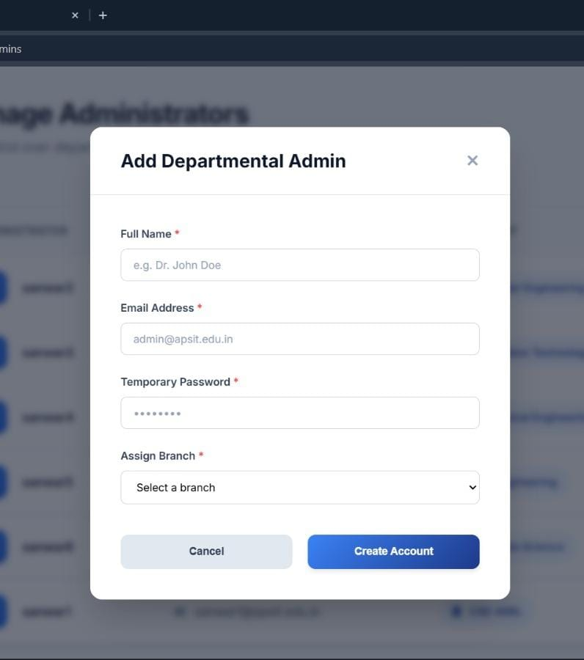
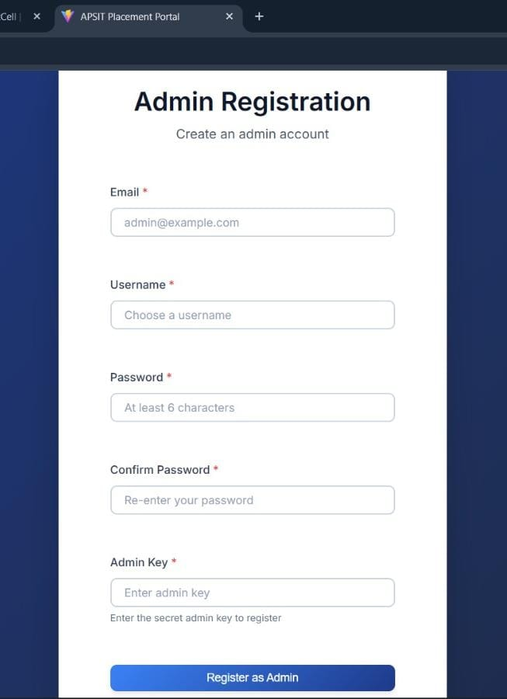

Slide 17
RESULTS & ANALYSIS
Observed Improvements:
Reduced manual effort significantly
Faster communication of placement updates
Centralized data storage
Improved tracking of student applications
Better coordination between departments and TPO
Efficient placement monitoring
Comparative Analysis
Feature | Manual System | Proposed System
Data Collection | Google Forms | Integrated Portal
Data Storage | Excel Sheets | Cloud Database
Company Updates | WhatsApp | Real-time Portal
Eligibility Check | Manual | Structured Data
Tracking | Difficult | Automated

Slide 18
CONCLUSION AND FUTURE WORK
The Student Placement Management System successfully replaces manual processes such as Google Forms, Excel sheets, and WhatsApp communication with a centralized web-based platform. The system improves transparency, reduces manual effort, enhances data security, and contributes towards digital transformation in education management.
FUTURE WORK
Automatic eligibility filtering
Email notification system
Dashboard analytics
Mobile responsive version
Admin shortlisting system
Resume filtering using AI
Company feedback system

Slide 19
REFERENCES
Our project is based on the following resources and technologies:
MySQL Documentation: Used for understanding database design, queries, and data management.
W3Schools: Used for learning HTML, CSS, JavaScript, and MySQL basics.
GeeksforGeeks: Used for concepts of database management, SQL queries, and problem-solving techniques.
MDN Web Docs: Used for understanding JavaScript functions, DOM manipulation, and web development concepts.
College Placement Portals: Studied existing systems to understand real-world placement processes and features.

Slide 20
Thank You...!!

